Slide 1
Programming Practices Day 2 Bridge Course

Slide 2
General Guideline
© (2010) Infosys Technologies Ltd.
This document contains valuable confidential and proprietary information of Infosys. Such confidential and proprietary information includes, amongst others, proprietary intellectual property which can be legally protected and commercialized. Such information is furnished herein for training purposes only. Except with the express prior written permission of Infosys, this document and the information contained herein may not be published, disclosed, or used for any other purpose.

Slide 3
Confidential Information
This Document is confidential to Infosys Technologies Limited. This document contains information and data that Infosys considers confidential and proprietary (“Confidential Information”).
Confidential Information includes, but is not limited to, the following:
Corporate and Infrastructure information about Infosys
Infosys’ project management and quality processes
Project experiences provided included as illustrative case studies
Any disclosure of Confidential Information to, or use of it by a third party, will be damaging to Infosys.
Ownership of all Infosys Confidential Information, no matter in what media it resides, remains with Infosys.
Confidential information in this document shall not be disclosed, duplicated or used – in whole or in part – for any purpose other than reading without specific written permission of an authorized representative of Infosys.
This document also contains third party confidential and proprietary information. Such third party information has been included by Infosys after receiving due written permissions and authorizations from the party/ies. Such third party confidential and proprietary information shall not be disclosed, duplicated or used – in whole or in part – for any purpose other than reading without specific written permission of an authorized representative of Infosys.

Slide 4
Recap of day1
Skills required for a software engineer
Computational Problems and classification
Mechanisms to solve computational problems
Testing of Pseudo code using Dry Run and Trace Table

Slide 5

Session Plan - Day 2
Introduction to SDLC
Importance of Coding Standards
Variables, Constants and Data Types
Control Structures
Nested Loops, break and continue statements
S

Slide 6
Introduction to Software Development (1 of 2)
Software Application
Software Project
Software Programmer
Computer Program
Can you recollect these terms?
Notes:
A Computer program is a series of steps specified for the solution to a problem, which a computer can understand and execute
A Software Application (or Application) is a collection of computer programs which address a real life problem for its end users
A Software Project (or Project) is an undertaking to create a software application by writing computer programs

Slide 7
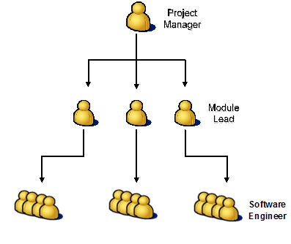
Introduction to Software Development (2 of 2)
A General Software Project Team structure
Notes:
Project Manager: Plans and manages the entire software project
Module Lead: Manages and leads the team working on a particular module within the software project
Software Engineer: Writes code. A software engineer also tests the code and delivers defect free code

Slide 8
Software Development Life Cycle
Notes:
Software Life Cycle:
The phases a software product goes through between when it is conceived and when it is deployed. The software life-cycle typically includes the following: requirement analysis, design, construction, testing (validation), and maintenance.
The software development lifecycle shown in the slide follows a Linear Sequential model, also called the waterfall model suggests a systematic, sequential approach to software development that begins at the system level and progresses through analysis, design, coding, testing and support.
Using these program specifications the actual programs are written. This is the coding phase. Once the project is built it is tested for conformance to specifications. Test plans are prepared using the specifications and these are used during the testing phase. If the project is tested successful, its then installed. The installation phase may also involve some kind of user training in some cases. The final phase of the SDLC life cycle would be then maintenance of the project . During maintenance some more new requirements are identified and the cycle continues.
The phases of SDLC will be covered in detail in the upcoming modules.

Slide 9
Coding Standards
Coding standards are set of conventions /procedures adopted to write code in a computer program
The coding standards may differ from project to project
This may also vary from customer to customer
Every company prepares its own coding standards
Adhering to coding standards has the following advantages:
Improves the readability of the program
Improves the clarity of the program
Makes a person to understand the program without any difficulty
Makes it easy to debug and maintain the program

Slide 10
Coding Standards - Guidelines
The Guidelines can be categorized as follows:
Variable Naming Conventions
File related conventions
Function related conventions
Commenting conventions
Indentation
Notes:
Guidelines for C Program writing are provided in the slide

Slide 11
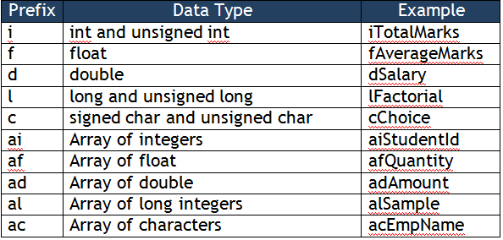
Variable Naming Conventions

Slide 12
File Related Conventions
File Header Block and File Footer
All source and header files must contain at the beginning of file, a section providing information about the source or the header file called the File Header block Format:
/****************************************************
* File : <filename>
* Description : <description>
* Author : <author> <company>
* Version : <version number>
* Date : <Date>
****************************************************/
All files should have this footer at the end of the file
/*********************************************************
* End of <filename>
*********************************************************/

Slide 13
Function Related Conventions
Function Header Block
All functions (or methods) in the C files should be preceded by a comment block
Format:
/**********************************************************
* Function: <Function Name>
* Description: <Overview of the function>
* Input Parameters:
* <Parameter 1> – <brief description>
* <Parameter 2> - <brief description>
* ... ... ... ... ... ... ... ...
* Returns : <Return values both in case of success and
* error conditions if the function returns something>
************************************************************/

Slide 14
Commenting Conventions
Comments are used to document programs and improve readability
The ratio of code to comments should be 10 : 3
Whenever there is a block of code which is doing something complex, sufficient amount of comments should be put in to explain
Comment should not be in the same line as the code
Use only C Style comments (/* This is a line of comment */)

Slide 15
Indentation
Indentation is the practice by Software Engineers to use spaces or tabs consistently in every line of code to group lines together based on their scope for easy readability
An indented code looks better and can be understood easily
The code in any line should not exceed 80 columns. If the column size exceeds 80, then \ can be used to continue in the next line

Slide 16
Bad and Good Indentation
Fig 1
Fig 2
Notes:
In the above snippet given, looking only at the indentation point of view, we can notice that in fig 1, the parenthesis of every block is not correctly aligned, and the comments have not been written, whereas in fig. 2 it is aligned with comments

Slide 17
Programming Basics

Slide 18
A complete program
#include <stdio.h>
int main(int argc, char **argv){
int iNum1;
scanf(“%d”,&iNum1);
printf(“%d”,iNum1);
/* Return success code to
the operating system */
return 0;
}
Pre processor directive
Entry point for program execution
Declaring a variable
Basic I/O functions
Each instruction in a C program terminates with a semicolon (;)
Notes:
Each C-program has a main function
Execution of a program starts from main()
The function ‘main’ should return zero if the program performed its job successfully or any other non zero value to indicate error
A block of code begins with an opening curly brace and ends with a closing curly brace.
The first line of the program is pre processor directive. Directives are executed during the preprocessor phase, a phase prior to compilation phase.
The program begins its execution with the first instruction in the main function.
printf() is a predefined function of the std I/O library which is made available to your program by including it using a #include directive.
Other predefined function is scanf() for accepting input from the user during execution.
Each instruction in a C program terminates with a semicolon.
Comments are inserted in the program for more clarity and readability of the programs. They are enclosed between /*….*/ or proceeded by //.
What should my "int main()" return?
As pointed out in the section above, it is extremely common for a program to return a result indication to the operating system. Some operating systems require a result code. And the return value from main(), or the equivalent value passed in a call to the exit() function, is translated by your compiler into an appropriate code.
The return values possible to the operating system from the program are :
The constant EXIT_SUCCESS defined in <stdlib.h> or <cstdlib> or zero The constant EXIT_FAILURE defined in <stdlib.h> or <cstdlib> or other than zero
If you use 0 or EXIT_SUCCESS your compiler's run time library is guaranteed to translate this into a result code which your operating system considers as successful.
If you use EXIT_FAILURE your compiler's run time library is guaranteed to translate this into a result code which your operating system considers as unsuccessful.
This is the reason why the return 0 statement is mentioned in the program
In earlier days of CUI (Command User Interface) programming, the data required by a program was given at the time of executing the program itself on command line hence the name command line arguments
int main(int argc, char **argv) indicates that the main function can accept command line arguments or parameters. Command line arguments or parameters are passed to a program when the program is executed. Example: In DOS to copy one file to another we can use the command copy file1 file2. Here file1 and file2 indicates the source and the destination file names. They are considered to be the arguments for the program copy. These arguments are stored into argv. The program should also check how many arguments are passed to the program. This will help the program to indicate the insufficient number of arguments if any. For example, if the command is given as copy file1 then the operating system cannot find the destination file name. In such cases, it will report an error. The number of arguments passed to the program are stored into argc. The data type int written before main indicates that the program will return an integer to the calling environment. The programs returns zero if the program performed its job successfully or any other non zero value to indicate error.
Even though void main() is also an applicable signature for main(), it is a NOT good programming practice.
More on command line arguments will be covered in the appendix
Note: argc and argv are user defined variable names.

Slide 19
Program Life Cycle
C Files
(Source Code)
Header Files
prog.c
help.c
strtest.c
stdio.h
func.h
Text Editor
C COMPILER
Pre-Processor
Preprocessed
Code
Software Developer
Compiler
Object Files
1011
11
0101
101101
010101
101
011101
101010
010
110
1010101
10101
101
prog.obj
help.obj
strtest.obj
10011
111
Runtime
Libraries
Linker
Executable File
(prog.exe)
Notes:
The diagram above depicts the various phases involved in the program life cycle.
Editing Phase : The first step in the process of building a program is creating source code files with the code statements in header and source files. The code statements are entered into the files using a standard editor (Visual Studio in our case). Care must be taken to enter the code such that it is properly formatted and follows programming standards. Since a program is the most detailed design specifications it must be easily understandable.
Preprocessing and Compiling phase : When the compiler is invoked the preprocessor (which performs the preliminary operations on the source code before they are passed to the compiler) runs first to create the compiler input. The compiler then scans the entire source code for any syntax errors and creates an OBJ file that contains machine code linker directives, sections, external references , function and data generated from the source files.
If there are any syntax errors the code is edited and recompiled. It is a good practice to review the code once the code passes the compilation stage to locate logic errors and ensure conformance to standards
Linking phase : During linking the linker combines all of the object code from the statically linked libraries and other object files, resolves the named resource and creates and executable. The linker gives an error message if an external reference is not found. Library is a catalog of previously developed objects ie sources which are independently developed, compiled and tested. Certain libraries are supplied along with the compiler. These standard libraries contain functions for performing the basic input/output , arithmetic etc functions. Users can create their own libraries. This is static linking wherein the code of the library files is included in the executable file. Hence it is a good practice to include only the required library files.
Debugging phase : During testing of the programs debuggers are used to execute the program instruction by instruction display intermediate result set new values to variable etc. Debuggers speedup the testing process. After the program is linked the final executable could be a debug version / final version product.

Slide 20
Data types
Data Types
User defined types
Derived types
structure
array
union
Built-in types
pointer
enumeration
Can you recollect the Basic data types?
integer type
void
floating type
int
char
float
double
Note: Discussion on Unions and enumerated data types is not in the scope
Notes:
float and double data types are used to store fractional values. The difference between float and double is in terms of the precision

Slide 21
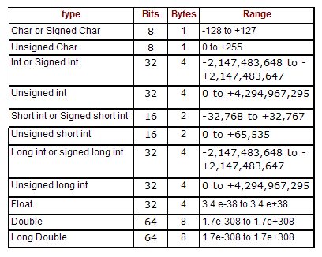
Range of Data Types (self study)
On VC++ compiler, the range of data types is as follows:
Note: Number of bytes and range given to each data type is platform dependent
Notes:
The number of bytes for data types specified in the table is for VC++ compiler.
The amount of memory occupied by int data type depends on the word length of the computer.
If the data type occupies n bits then the range of values supported by the data type is calculated using the following formulae:
For signed : -2^{n-1} to +2^{n-1}-1
For unsigned : 0 to 2^{n}-1

Slide 22
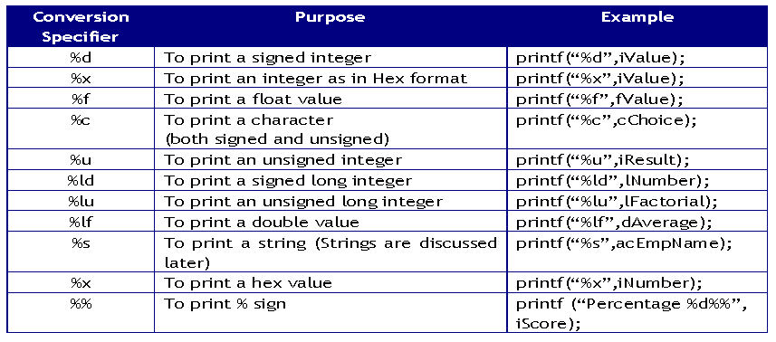
Basic I/O Functions (1 of 4)
Syntax:
printf(“Conversion Specifier-list”,variable-1,
variable-2,…………………);
int iEmployeeId = 1001;
printf(“Employee Id %d” , iEmployeeId);
Notes:
Conversion specifier %x or %X can be used to display an integer value in its hexadecimal equivalent.
Ex: int iNum = 11;
printf(“%X”, iNum ) ; -→ displays B
Conversion specifier %o can be used to display an integer value in its octal equivalent.
Ex: int iNum = 9;
printf(“%X”,iNum ) ; -→ displays 10
Eg.. putchar(5); will print the character equivalent to the ASCII value 5.
putc(65,stdout) will print the character equivalent to the ASCII value 65 which is ‘A’
char cCh=‘*’; putchar(cCh) will print character * on the screen
char cCh=‘*’; putc(cCh,stdout) will print character * on the screen
Common programming errors:
Forgetting the conversion specifier in the first part of printf function when there are variables in the second part

Slide 23
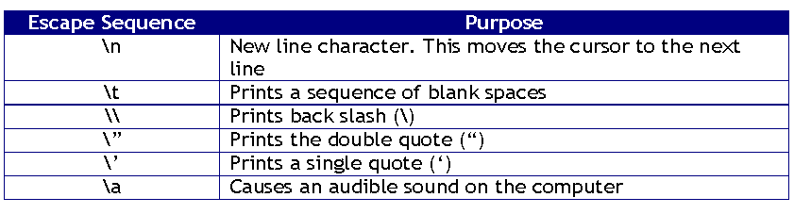
Basic I/O Functions (2 of 4)
An escape sequence is interpreted to have a special meaning in the screen output
All the escape sequences must be preceded by a back slash (\)
Escape sequences are non printable characters
Escape sequences are generally used with ‘printf’ function

Slide 24
Basic I/O Functions (3 of 4)
‘scanf’, uses a similar conversion specifier like ‘printf’ to read different types of data from the keyboard
The parameters passed to the function ‘scanf’ after the format are pointers (address of the variables) to the data types being read from keyboard
Syntax:
scanf(”Conversion Specifier”, address of variables);
Example:
/* To read an integer */
printf(“Enter a number: ”);
scanf(“%d”, &iCount);
/* To read a float */
printf(“Enter Amount: ”);
scanf(“%f”, &fAmount);
Common programming error:
Not including ‘&’ before the variable name
Missing comma between the conversion specifier and variable name
Mismatch in the number and type of conversion specifier for the used variables
Notes:
The scanf statement is used for accepting user input.
In scanf the variables are pointers that indicate the address of data items in memory. More about pointers later
A standard library function used often in conjunction with scanf is the fflush(stdin); function. This function is responsible for clearing the input buffer before / after any input operation.
If there is no address operator (&) specified the compiler does not generate any compile time error. That means the program can compile successfully. It may just generate only warnings depending on the compiler. But when the user gives the data during run time the data does not get stored because there is no address specified.
Common Programming Errors:
Forgetting & along with the variable name.
The number of conversion specifiers may not match the number of variables
Good programming practice: Use a printf statement before the scanf statement that displays a message what the user is to enter. This is called interactive programming.

Slide 25
Basic I/O Functions (4 of 4)
/* Reading multiple input */
short iDay,iMonth,iYear;
printf("Enter day, month and year in format
(dd mm yyyy)");
scanf("%d %d %d",&iDay,&iMonth,&iYear);
/* Reading character input */
char cChoice;
printf(“Want to continue “);
fflush(stdin);
scanf(“%c”,&cChoice);
Use fflush(stdin) statement to clear the input buffer before reading a char/string using a scanf
Notes:
Use fflush(stdin) statement to clear the input buffer before reading a char/string using a scanf otherwise the scanf will take a previous char from the buffer and will not wait for you to enter a char from the keyboard.

Slide 26
Character data type
A character data type in C Language is 1 byte (8 bits) long
The range of data a character can contain is as follows:
char: -128 to +127
unsigned char: 0 to 255
A char data type can store a single character at any point of time
Character data type can be used as an integer for arithmetic operations also
Notes:
Text processing is very much used in production like storing a list of names, searching for a name in the data base etc…
Fundamentally, computers just deal with numbers. They store letters and other characters by assigning a number for each one.
ASCII stands for American Standard Code for Information Interchange. Computers can only understand numbers, so an ASCII code is the numerical representation of a character such as 'a' or '@'. ASCII was developed a long time ago and now the non-printing characters are rarely used for their original purpose. ASCII was actually designed for use with teletypes and so the descriptions are somewhat obscure. If someone says they want your CV however in ASCII format, all this means is they want 'plain' text with no formatting such as tabs, bold or underscoring - the raw format that any computer can understand. This is because they can easily import the file into their own applications without issues. Notepad creates ASCII text, or in MS Word you can save a file as 'text only' . Now a days, computers follow Unicode which occupies 16-bits (2 bytes). This unicode is capable of representing characters from any language which has written script including Indian languages.

Slide 27
ASCII Character Set
ASCII is the acronym for American Standard Code for Information Interchange
Code used to represent English alphabets, numerical digits and commonly used symbols as numbers
Other Character sets: EBCDIC (Mainframes) and UNICODE (2 byte character set)
C language uses ASCII and Java uses Unicode to represent non numeric characters
Notes:
EBCDIC is an abbreviated form of Extended Binary Coded Decimal Interchange Code. This is used in mainframe computers.
Unicode used by Java language occupies 2 bytes. It can accommodate 65,535 characters. All the language alphabets (Including Indian, Japanese, Chinese, Thai etc.) can be represented using Unicode.

Slide 28
Declaring and Using Character Variables
Syntax:
char variablename1, variablename2,….;
Example:
char cAlphabet;
char cStatus;
The value can be assigned by enclosing it in a single quote (‘ ‘)
Example:
cAlphabet = ‘W’;
cStatus = ‘y’;
A character variable can be assigned with a numeric value by directly assigning a number
Example:
cAlphabet = 77;
The above statement can also be written as cNumber = ‘M’;

Slide 29
Printing a character on screen
The ASCII value of the character stored into the variable can be printed using printf() function
Example:
char cStatus=‘y’;
printf(“%d”,cStatus);
The above printf() will print ASCII value of ‘y’ which is 121
Arithmetic operations can also be performed on character variables
Example:
char cStatus=‘A’;
cStatus = cStatus + 2;
printf(“%c”,cStatus);
The above printf() will print the character ‘C’.
The ASCII value of ‘A’ which is 65 is added with 2 and it becomes 67. ASCII value 67 represents the character ‘C’

Slide 30
Preprocessor Directives
#define directive tells the preprocessor to search and replace a pattern in code
A #define directive is sometimes also known as a Macro
#define PASSPERCENT 65
int main(int argc, char **argv) {
/* PASSPERCENT macro being used in code */
printf (“Pass percentage is: %d\n”, PASSPERCENT);
/* Return a success code to Operating System */
return 0;
}
A preprocessed code looks like this:
int main(int argc, char **argv){
printf (“Pass percentage is: %d\n”, 65);
return 0;
}
Notes:
Example2:
#define PRINT printf("Hello ") ;\
printf("World\n");
int main(int argc, char **argv) {
/* PRINT macro being used in code */
PRINT
/* Return a success code to Operating System */
return 0;
}
A preprocessed code looks like this after substitution:
int main(int argc, char **argv) {
/* PRINT macro being used in code */
printf("Hello ") ;
printf("World\n");
/* Return a success code to Operating System */
return 0;
}

Slide 31
Can you answer these questions?
1.”Software engineers know about the code written by them”.
Then, why are coding standards and documentation important ?
2.What happens in preprocessor stage of the program life cycle?
3.Why is the range of data types important?
4.What is the output of the following snippet:
char cCh=65;
printf("%c",cCh);
printf("\n%d",cCh);
Explain the output
Notes:
The code which is written by one software engineer may be enhanced/maintained by the other, or by himself at a later period. Also during integration it becomes easier if the team follows standard guidelines and hence is very important. It is important to note that the program length might be longer with documentation, but these lines are not considered by the compiler while compilation
As the term suggest, this stage happens before compilation. If preprocessor directives are present, they are processed first . For. Ex. When # define statements are present, substitution would take place and similarly for #include statements specified header file is included in the source code
When a variable is declared, for handling data appropriately it is necessary for us to know the type of value and the precision required to be held in case of floating point numbers. Using this information, the appropriate datatypes can be used for the declaration
The output would be A for the first printf statement and 65 for the next. This happens because of automatic conversion in C language. The ASCII table is used and hence 65 gets printed . This is also an example of conversion without loss of data

Slide 32
Operators
The following are the operators that are used in a program
Arithmetic operators
Assignment operator
sizeof operator
Logical operators
Relational operators
Increment and Decrement Operators
Notes:
The basic arithmetic operators help us in performing the arithmetic operations. The % (modulo operator) is used to find the reminder of a divide operation
ex.int iNum1=5,iNum2=2;
int iNum3=5/2; will store 2 in iNum3
int iNum3=5%2 will store 1 in iNum3
% operator cannot be applied to float data type. Hence the instruction 5.2 % 2.5 will result in error
For comparing if 2 values are equal or not remember to use == and not a single =. == indicates comparisons and = indicates assignment operation
ex. int iNum1=5,iNum2=3
iNum1==iNum2 will be considered as an conditional expression that will be evaluated to true(non-zero) or false(zero)
iNum1=iNum2 will be considered as an assignment expression which will assign 3 (value of iNum2) to iNum1. iNum1 after the instruction will have value 3.
The basic arithmetic operators help us in performing the arithmetic operations. The % (modulo operator) is used to find the reminder of a divide operation
ex.int iNum1=5,iNum2=2;
int iNum3=5/2; will store 2 in iNum3
int iNum3=5%2 will store 1 in iNum3
% operator cannot be applied to float data type. Hence the instruction 5.2 % 2.5 will result in error
For comparing if 2 values are equal or not remember to use == and not a single =. == indicates comparisons and = indicates assignment operation
ex. int iNum1=5,iNum2=3
iNum1==iNum2 will be considered as an conditional expression that will be evaluated to true(non-zero) or false(zero)
iNum1=iNum2 will be considered as an assignment expression which will assign 3 (value of iNum2) to iNum1. iNum1 after the instruction will have value 3.
Logical operators available are ! (NOT), && (AND), || (OR)
ex. consider 3 variables iNum1, iNum2, iNum3 containing values 1,2,3 respectively
iNum1=1, iNum2=2, iNum3=3
the condition iNum1==1 && iNum2 == 3 will evaluate to false
the condition iNum1==1 && iNum3==3 will evaluate to true
the condition iNum1==1 || iNum2==3 will evaluate to true
the condition iNum1==1 || iNum3==3 will evaluate to true
the condition !(iNum1 <2 && iNum2==2) will evaluate to false
AND table followed for evaluation is : T && T~T, T && F~F, F && T~F, F && F~T
OR table followed for evaluation is : T || T~T, T || F~T, F || T~T, F || F~F
NOT table followed is : ! T~F,! F~T
Classification of Operators:
Based on the number of operands:
Unary operators ++, --, !
Binary operators +,-,*,/,%,==,<,>,>=,<=,!=,&&,||
Ternary operators ? :
(2) Based on the operations performed:
Arithmetic operators
Relational operators
Logical operators

Slide 33
Type Casting
Temporary conversion of one data type into another
In some situations, the compiler will automatically convert one data type into another
Type casting is an overhead for the compiler and should be used only when it is absolutely necessary
Example:
float fResult;
fResult = 7 / 2 ;
The variable fResult will store 3.0 instead of 3.5
To get the ‘float’ value, the expression should be:
fResult = 7.0 / 2; or fResult = 7 / 2.0; or
fResult = 7.0 / 2.0; or
fResult = (float) 7 / 2; or fResult = 7 / (float) 2;
Notes:
C language has “Implicit Type conversion” in some cases. For. Ex. When the following expression is written-
char cCh=65;
printf(“%c”,cCh);/* This would print A*/
65 is number assigned to a character which implicitly would assign ‘A’.
This type conversion might result in loss of data. For. Ex: when a float value is assigned to an int variable, the precision might be lost. To avoid this, explicit typecasting may be done as shown in the slides.

Slide 34
sizeof operator
sizeof operator is used to find the number of bytes required for a data type
sizeof operator returns an integer
Example:
int iNumber=5;
float fValue = 6.7;
printf(“The size of int is %d bytes\n”,sizeof(iNumber));
printf(“The size of float is %d bytes\n”,sizeof(fValue));
printf(“The size of char is %d bytes\n”,sizeof(char));
printf(“The size of double is %d bytes\n”,sizeof(double));
printf(“The size of float literal value is %d bytes\n”,sizeof(2.3f));
printf(“The size of integer literal value is %d bytes\n”,sizeof(2));
Since sizeof returns an integer %d is used as the conversion specifier
sizeof can accept either a pre declared variable or any valid data type or a literal constant

Slide 35
Increment and Decrement Operators
Operators ++ and -- are called as increment and decrement operators
These operators increment or decrement the variable’s value by 1
They are also called as unary operators because they have only one operand to operate
If the operator is used before the operand, it is prefix and if the operator is used after the operand, it is postfix
Example:
++iValue and -–iValue is called as prefix
iValue++ and iValue-- is called as postfix

Slide 36
Can you answer these questions?
1. Expression1 (4+3)*5/2-8
Expression2 4+3*5/2-8
Will the above expressions lead to same result?
fValue = 4 + 3 * (float)5/2-8
What will be the value in fValue ? Can you tell the alternate ways to achieve the same result without using explicit typecast?
Consider the declaration :
int iNum1=5,iNum2 = 0;
a. ( (iNum1 == 5) || (iNum2 = iNum1))
What is the value in iNum2 after executing above condition?
b. ( (iNum1 == 5) && (iNum2 = iNum1))
What is the value in iNum2 after executing above condition?
Notes:
Expression1 = 9 Expression2 = 3
3.5 and alternate ways of representation is given in A,B and C
A) 4 + 3 * 5.0/2 -8
B) 4 + 3 * 5/2.0 – 8
C) 4 + 3 * 5.0/2.0 – 8
3. a) 0
b) 5

Slide 37
Control Structures

Slide 38
Control Structures
A control structure refers to the way in which the Programmer specifies the order of executing the statements
Sequential
All the statements are executed in the same order as it is written
Selection or Conditional
Based on some conditions, different set of statements are executed
Iteration or Repetition or Looping
Certain statements are executed repeatedly

Slide 39
Simple if Statement
The ‘if’ statement is a conditional construct
When the condition is true, a set of statements are executed and when it is false another r set of statements are executed or another condition is checked
if (condition-1) {
Statement set-1;
}
else if (condition-2) {
Statement set-2;
}
else if (condition-n) {
Statement set-n;
}
else {
Statement set-x;
}
Next Statement;
if (fRateOfInterest = 6.5) {
printf(“Minimum Duration
of deposit: 6 years”);
}
else if (fRateOfInterest=6.0){
printf(“Minimum Duration
of deposit: 3 years”);
}
else {
printf(“No such interest
rate is offered”);
}

Slide 40
Difference between = and == operators
The comparison operator (==) compares two values for equality
The assignment operator however (=) assigns the value on the right side to the variable on the left side
The operator ‘=’ is used for assignment purposes whereas the operator ‘==’ is used to check for equality
It is a common mistake to use ‘=’ instead of ‘==’ to check for equality
The compiler does not generate any error message when = is used in place of ==

Slide 41
Assignment(=) vs. Equality Operator (==)
if (6.5 = fRateOfInterest) {
printf(“Minimum Duration of deposit: 6 years”);
}
else if (6.0 = fRateOfInterest){
printf(“Minimum Duration of deposit: 3 years”);
}
else {
printf(“No such interest rate is offered”);
}
if (6.5 == fRateOfInterest) {
printf(“Minimum Duration of deposit: 6 years”);
}
else if (6.0 == fRateOfInterest) {
printf(“Minimum Duration of deposit: 3 years”);
}
else {
printf(“No such interest rate is offered”);
}
Wrong code
Corrected code
Notes:
When the above code is compiled it generates compilation errors because the variable’s value is being assigned to a constant
This helps in trapping the error at compile time itself, even before it goes to unit testing

Slide 42
switch case Statement
The ‘switch’ statement is a selectional control structure that selects a choice from the set of available choices
Syntax:
switch(integer variable or integer expression or
character variable) {
case integer or character constant-1 : Statement(s);
break;
case integer or character constant-2 : Statement(s);
break;
case integer or character constant-n : Statement(s); break;
default:Statement(s);break;
}
Notes:
The switch statement is a multi directional conditional control statement.
Whenever a choice is to be made among a of alternatives, we use switch statement.
The switch block is used as an alternative to if construct when the value in a variable needs to be matched against a set to values.
The expr needs to be of integral type only. All case values need to be unique. number
The switch-case help control complex conditional and branching operations. The expr value is matched against all case values. If a match is found the case block executes and the control comes out of the switch (becoz of a break). In absence of a break statement the execution continues with the next case block till it encounters a break / the switch block terminates (which ever is earlier).
If expr does not match with any of the listed case values then the default block executes. The default is an optional statement and it need not come at the end; it can appear anywhere in the body of the switch statement.
This is one of the code tuning techniques in which we place cases according to the frequency which they occur in to reduce the number of comparisons. More bout this we discuss in code tuning techniques in the later day slides
The break statement has two uses:
To terminate the case in the switch statement (refer to switch slides)
To force the termination of a loop. When a break statement is encountered in a loop, the loop terminates immediately and the execution resumes the next statement following the loop.

Slide 43
What is the output of the following code snippet?
int iNum = 2;
switch(iNum){
case 1:
printf(“1”);
break;
case 2:
printf(“2”);
break;
case 3:
printf(“3”);
break;
default:
printf(“INVALID”);
break;
}
2

Slide 44
Loop Structures
Loop structures are iterational constructs
Syntax of while loop:
while (condition) {
Set of statements;
}
Next Statement;
Syntax of do..while loop:
do {
Set of statement(s);
} while (condition);
Next Statement;
Syntax of for loop:
for (Initialization; Termination-Condition; Increment-Step){
Set of statement(s);
}
Next Statement;

Slide 45
What is the output of the following code snippet?
unsigned int iCount = 1;
while (iCount<10);
{
printf("%u",iCount);
}
Because of THIS → ;
Does not display anything on the screen!!!
Results in an infinite loop.. WHY???

Slide 46
break, continue and exit –Loops (1 of 2)
When a ‘break’ statement is encountered in a loop, the loop terminates immediately and the execution resumes with the next statement following the loop
If it is used in a nested loop, it quits only the loop from where it is called
‘continue’ statement forces the next iteration of the loop to take place and skips the code between ‘continue’ statement and the end of the loop
Notes:
Note:
break statement
‘break’ statement can be used in an if statement only when the if statement is written in a loop (while, do while or for)
Just an if statement with ‘break’ (without loops) leads to compilation error
continue statement:
When a continue statement is encountered in a for loop causes looping-expression to be evaluated, i.e. the execution goes to the beginning of the loop without executing the statements after continue in that iteration.
exit statement
This function is defined in ‘stdlib.h’ header file
Syntax:
exit(int status);
The status code zero indicates that the program completed successfully
If there is a failure any other code has to be returned

Slide 47
break, continue and exit –Loops (2 of 2)
In case of for loop, ‘continue’ makes the execution of the increment portion of the statement and then evaluates the conditional part
In case of while and do-while loops, ‘continue’ makes the conditional statement to be executed
The function ‘exit’ is used to quit the program
Terminates the program and returns the status code to the operating system
Notes:
Note:
break statement
‘break’ statement can be used in an if statement only when the if statement is written in a loop (while, do while or for)
Just an if statement with ‘break’ (without loops) leads to compilation error
continue statement:
When a continue statement is encountered in a for loop causes looping-expression to be evaluated, i.e. the execution goes to the beginning of the loop without executing the statements after continue in that iteration.
exit statement
This function is defined in ‘stdlib.h’ header file
Syntax:
exit(int status);
The status code zero indicates that the program completed successfully
If there is a failure any other code has to be returned

Slide 48
What is the output of the following code snippet?
int iCounter1=0;
int iCounter2;
while(iCounter1 < 3) {
for (iCounter2 = 0; iCounter2 < 5; iCounter2++) {
printf("%d\t",iCounter2);
if (2 == iCounter2){
break;
}
}
printf("\n");
iCounter1 = iCounter1 + 1;
}
Quits only the innermost for loop
0 1 2 is printed 3 times

Slide 49
What is the output of the following code snippet?
int iCount = 1;
do {
printf(“%d\t”,iCount);
iCount++;
if (5 == iCount) {
continue;
}
} while(iCount < 10);
Output: 1 2 3 4 5 6 7 8 9

Slide 50
What is the output of the following code snippet?
int iCount;
for (iCount=1;iCount <= 10; iCount++) {
if (0 == iCount % 2) {
continue;
}
printf(“%d\t”,iCount);
}
Output: 1 3 5 7 9

Slide 51
What is the output of the following code snippet?
int iCount = 1;
while (iCount < 10) {
if (5 == iCount) {
continue;
}
printf(“%d\t”,iCount);
iCount++;
}
Output: 1 2 3 4 and then infinite loop

Slide 52
What is the output of the following code snippet?
int iCount,iValue;
for (iCount=1;iCount <= 5; iCount++) {
for (iValue =1; iValue <= 3; iValue++) {
if (2 == iValue) {
break;
}
printf(“%d\t”,iValue);
}
}
Output: 1 1 1 1 1

Slide 53
Can you answer these questions?
If the number of iterations is known and is of specific increment type in each iteration, which loop would you prefer to use?
2. A menu needs to be displayed to the user till he chooses quit. Which loop would you prefer?
3. Can a for loop be written without a body?
4. If break statement is used in a nested inner loop, what happens?
5. How can we write a loop which runs infinitely till the program chooses to exit?
Notes:
for loop
A do..while loop as the menu has to be shown atleast once and then depending on the choice of the user appropriate action can be taken
Yes
For example:
for(iNum=0;iNum<10;iNum++);
4. Only the inner loop is terminated
5. while(1) or for(;;) or do -- while(1)

Slide 54
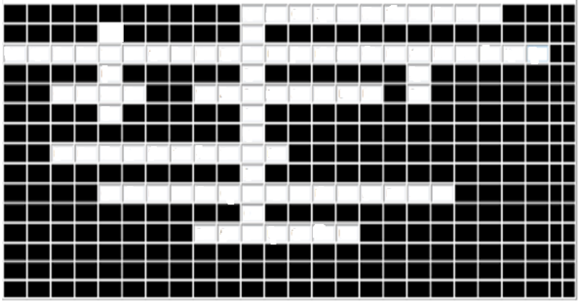
Here is a crossword for you…
9
8
1
10
2
3
4
5
6
7
Across
This is done at the coding phase
In this programming approach, all the code is written in a single continuous program
What is the datatype name to store a single alphabet?
Quantity that can change during execution
All the files should have this at the end of the file
This improves the readability and clarity of the program
This is used when the number of times the loop to be executed is known
Down
Statement used to terminate a loop
# define directive is handled by this
Logical operator which evaluates the second expression only when the first expression is true

Slide 55
Summary(1 of 3)
SDLC
Importance of Coding Standards
Variables, Constants, Data Types and Operators

Slide 56
Summary (2 of 3)
Control structures
Always use ‘else if’ statement when sequence of conditions need to be tested.
Assignment (=) operator assigns the value to a variable and equality (==) operator checks whether the values are equal or not
An ‘if’ within another ‘if’ is called as ‘nested if’
When a variable is to be checked for equality with a set of constants, use ‘switch’ statement

Slide 57
Summary (3 of 3)
Iterational control structures
‘while’ loop tests the condition before entering into the loop
‘do while’ loop tests the condition at the end of the loop
When the statements have to be executed for specific number of times, ‘for’ loops are used
Proper initialization, termination condition and increment step will avoid the problem of infinite loops
A loop within another loop is called as ‘nested loop’
Control transfer statements
Quitting the loops-‘break’ statement
Continuing the loops-‘continue’ statement

Slide 58
Thank You
“The contents of this document are proprietary and confidential to Infosys Technologies Ltd. and may not be disclosed in whole or in part at any time, to any third party without the prior written consent of Infosys Technologies Ltd.”
“© 2008 Infosys Technologies Ltd. All rights reserved. Copyright in the whole and any part of this document belongs to Infosys Technologies Ltd. This work may not be used, sold, transferred, adapted, abridged, copied or reproduced in whole or in part, in any manner or form, or in any media, without the prior written consent of Infosys Technologies Ltd.”

